Slide 1
LJUBLJANA
All you need to know about where to sleep,eat, visit and enjoy
Aljana Smajlović, Katarina Brezovar, Janez Gošte,
OŠ Ivana Skvarče, Slovenia
In your pocket

Slide 2
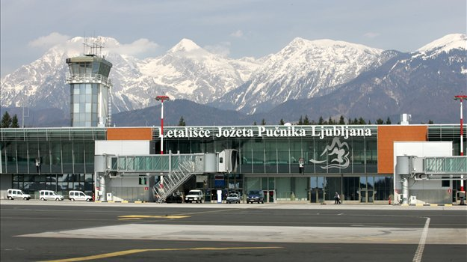
ARRIVING IN LJUBLJANA
1.
Arriving by plane
Ljubljana’s cosy little Jože Pučnik Airport is 26km north of the city, near Brnik.
Arriving by bus
All national and international buses arrive at the central bus station, which is located directly in front of the main train station.
Arriving by train
Slovenian Railways (Slovenske železnice) - clean modern trains that usually arrive on time.

Slide 3
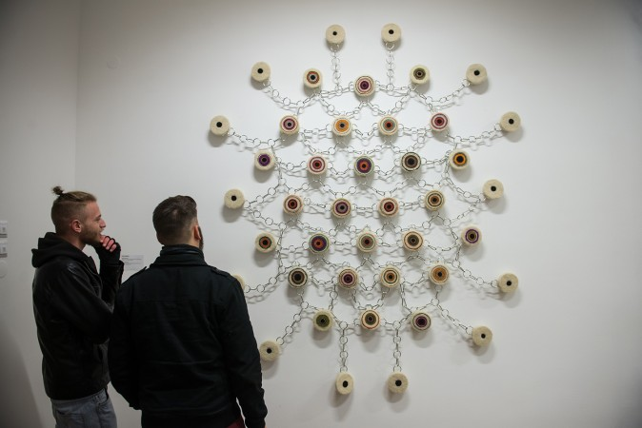
CULTURE & EVENTS
2.
Cinemas
Kinodvor, Kolosej, …
Tickets cost around 5€
Galleries
City Gallery, BeArtAngel, Aksioma project Space, Jakopič Gallery.
Theatres
National Drama Theatre, Slovenian Youth Theatre, Gledališče Glej.
Cultural centres
Cankarjev Dom, KUD France Prešeren, Metelkova mesto
( Alternative Culture Centre)
Concert Halls
Centre Stožice, Hala Tivoli, Slovenian Philharmonic.
City Gallery

Slide 4
3.
|
RESTAURANTS & FOOD
Those who care about what they eat will appreciate the rich culinary offer in Ljubljana.
Asian
Beli Labod, Maru, Moysushi, Shambala...
Balkan
Das is Valter, ...
If you are wondering why one of Ljubljana‘s most popular Balkan restaurants has a distinctly German name, the answer lies in the 1972 Yugoslav cult classic Valter Brani Sarajevo (Walter Defends Sarajevo). Perhaps most impressive is the fact that all feels completly authentic, while the heaping plates of grilled meat are not only mouthwateringly delicious, but also ridiculously inexpensive.
Georgian
Zlato Runo
Slovenia‘s only Georgian restaurant is still unknown to many locals.
Indian
Namasté
It is the longest running Indian restaurant in Slovenia.
International
Argentino, ...
Based on a classic Argentinean hacienda. Latin American dishes and some of the best steaks in Ljubljana.
Italian
Al Capone, Casa Nostra, ...
Middle Eastern
Laziz
Ljubljana finally got a restaurant serving authentic Arabic cuisine. The food in Laziz is prepared by a chef from Alexandria, the culinary capital of Egypt.

Slide 5
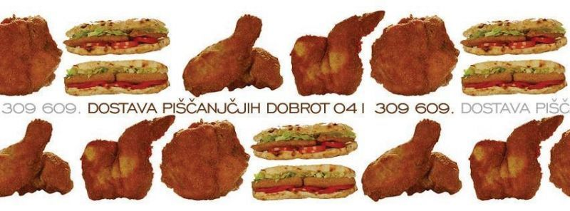
Ljubljana’s famous fried
Chicken is made in a special
way and contains 90% less fat that an
ordinary fried chicken.

Slide 6
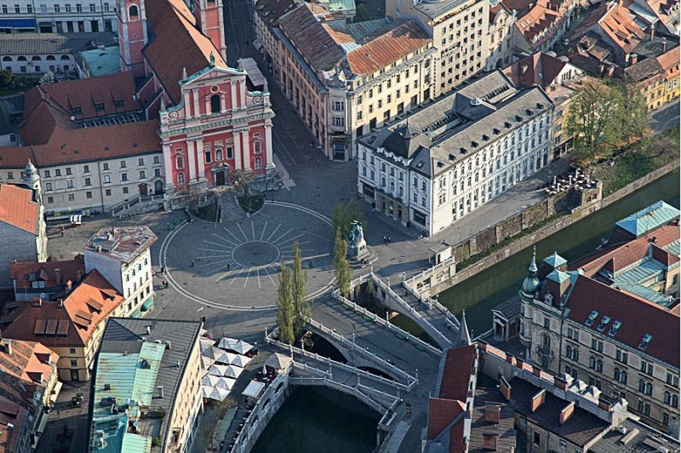
TROMOSTOVJE
4.
Tromostovje is a group of three bridges across the
Ljubljanica River. It connects the Ljubljana's
historical, medieval town on one bank and the
modern city of Ljubljana, capital
of Slovenia, on the other.
Tromostovje (Triple Bridge)
More about Triple bridge: https://www.youtube.com/watch?v=IxZggD2x1UE

Slide 7
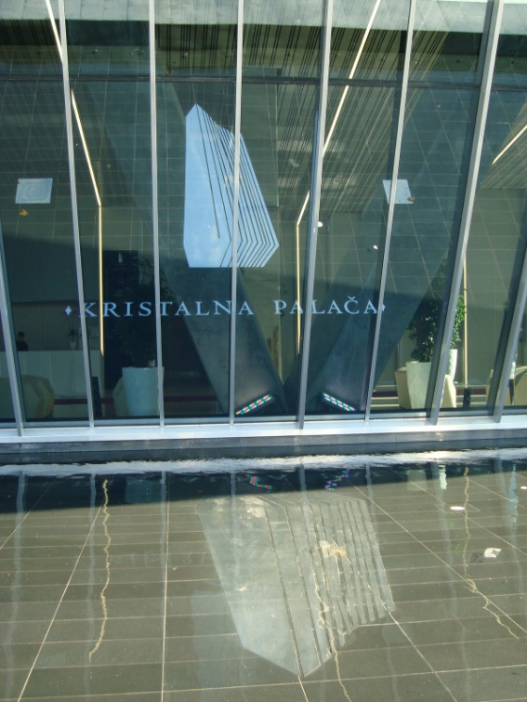
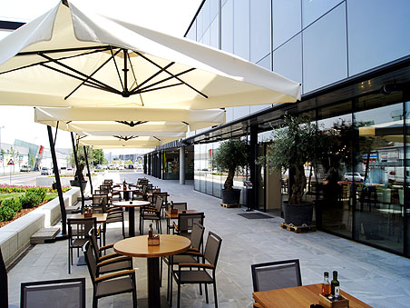
5.
|
KRISTALNA PALAČA
Kristalna palača (Crystal Palace) is the tallest
building in Slovenia and also the tallest building
in Ljubljana with several shops, cafés and
restaurants.

Slide 8
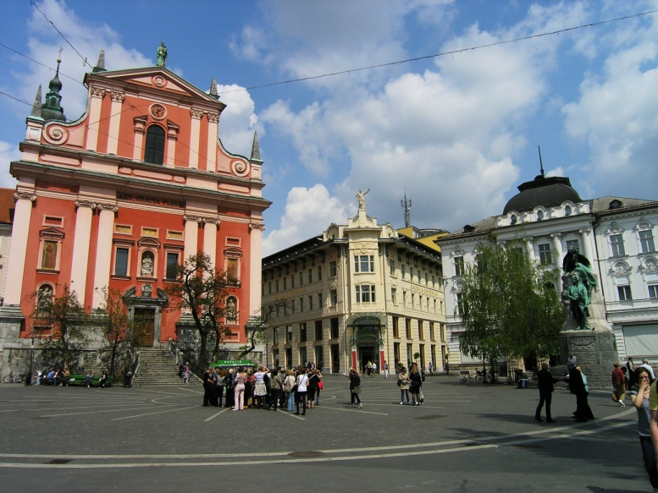
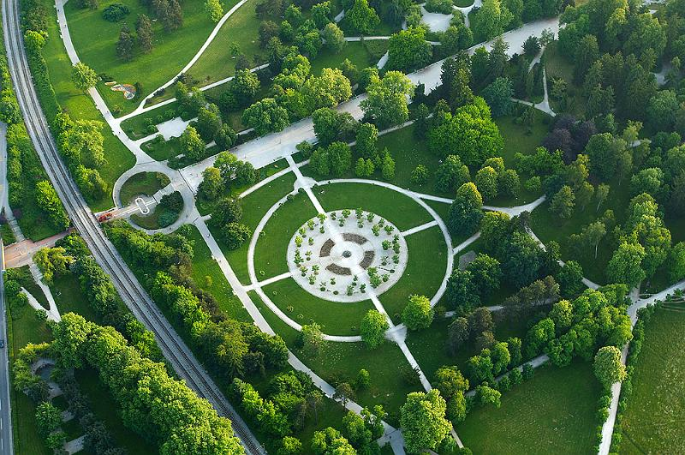
6.
|
SIGHTS
Zmajski most. One of the most photographed
sights in Ljubljana, Dragon Bridge.
Prešernov trg. It‘s no exaggeration to say that
Prešeren Square is not only the centre of
Ljubljana, but truly the spiritual centre of the
Slovene nation.
Tivoli. Ljubljana’s central park Tivoli offers countless
paths, fields and play areas, as well as forest trails
on Rožnik Hill.

Slide 9
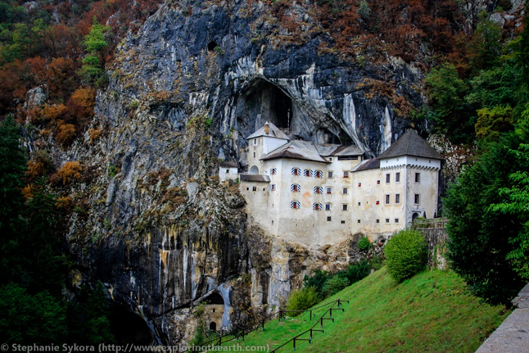
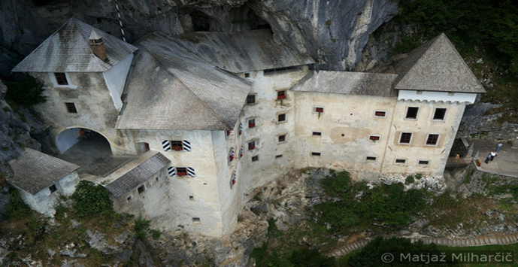
7.
|
PREDJAMA CASTLE, POSTOJNA
Predjama Castle is a Renaissance castle built within a cave mouth in the historical region of Inner Carniola. It is located in the village of Predjama, approximately 11 kilometres from the town of Postojna.

Slide 10
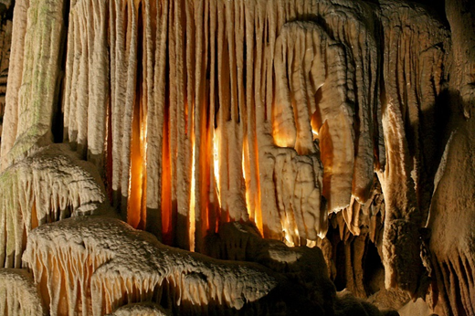
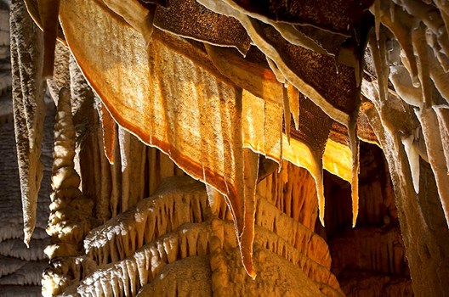
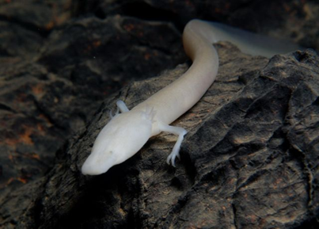
8.
|
Postojna Cave is one of the best-known caves in the world. It is also the greatest tourist attraction in Slovenia and one of the world's largest karst monuments. A fantastic web of tunnels, passages, galleries and halls, the astonishing diversity of Karst features as well as easy access are certainly the main reasons for such popularity of the cave and a large number of visitors.

Slide 11
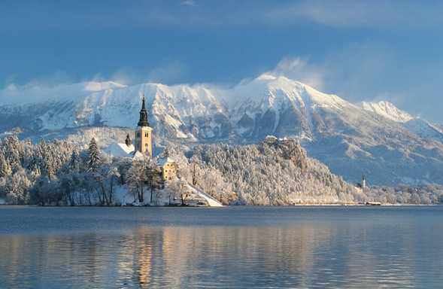
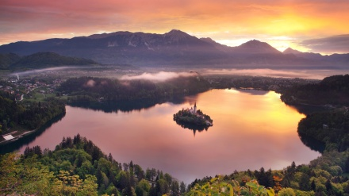
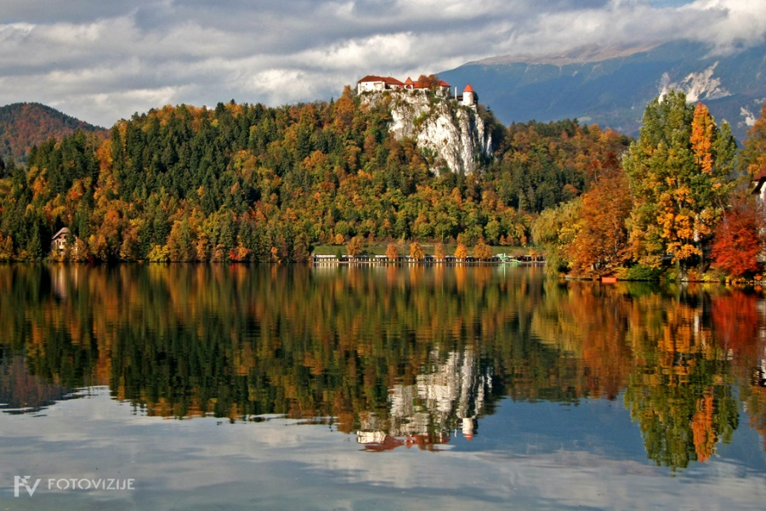
9.
|
LAKE BLED IN 4 SEASONS
The lake island with its glorious Gothic church and the famous wishing bell. Every wish can come true. Ring the wishing bell and believe.

Slide 12
SOURCES:
All photos from: https://www.google.si/imghp?hl=sl&tab=wi&ei=ys23VMOVHcfmUvHUgqgC&ved=0CAQQqi4oAg
Ljubljana in your pocket, oct-nov 2013
http://www.bled.si/si/

